Slide 1
Classical Encryption Techniques
By
Dr. Zia ur rehman

Slide 2
Symmetric encryption
Plaintext – Original message
Ciphertext – Coded message
Enciphering or Encryption - The process of converting from plaintext to ciphertext.
deciphering or decryption - restoring the plaintext from the ciphertext.
Cryptanalysis - Techniques used for deciphering a message without any knowledge of the enciphering. It is also called breaking the code.

Slide 3
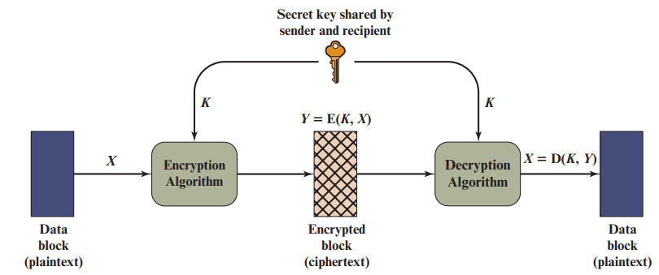
SYMMETRIC CIPHER MODEL
Encryption algorithm: The encryption algorithm performs various substitutions and transformations on the plaintext.
Secret key: The secret key is also input to the encryption algorithm. The key is a value independent of the plaintext and of the algorithm.
Decryption algorithm: This is essentially the encryption algorithm run in reverse. It takes the ciphertext and the secret key and produces the original plaintext.
Notes:
We need a strong encryption algorithm. The opponent should be unable to decrypt ciphertext or discover the key even if he or she is in possession of a number of ciphertexts together with the plaintext that produced each ciphertext.
Sender and receiver must have obtained copies of the secret key in a secure fashion and must keep the key secure.

Slide 4
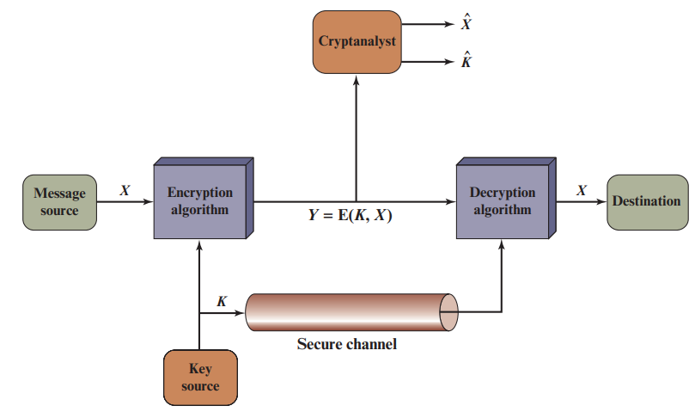
Model of Symmetric Cryptosystem

Slide 5
Cryptanalysis and Brute-Force Attack
There are two general approaches to attacking a conventional encryption scheme.
Cryptanalysis: Cryptanalytic attacks rely on the nature of the algorithm plus perhaps some knowledge of the general characteristics of the plaintext or even some sample plaintext–ciphertext pairs.
Brute-force attack: The attacker tries every possible key on a piece of cipher text until an intelligible translation into plaintext is obtained. On average, half of all possible keys must be tried to achieve success.

Slide 6
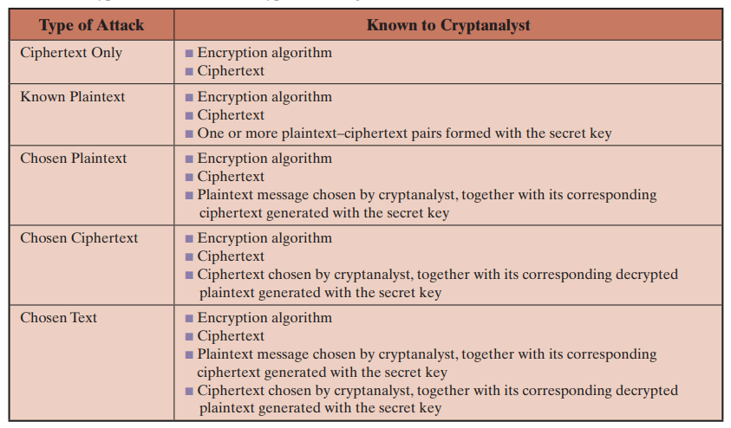
Cryptanalysis
The table summarizes the various types of cryptanalytic attacks based on the amount of information known to the cryptanalyst.
Notes:
The most difficult problem is presented when all that is available is the ciphertext only. In some cases, not even the encryption algorithm is known, but in general, we can assume that the opponent does know the algorithm used for encryption. One possible attack under these circumstances is the brute-force approach of trying all possible keys. The ciphertext-only attack is the easiest to defend against because the opponent has the least amount of information to work with.
With known plaintext. With this knowledge, the analyst may be able to deduce the key on the basis of the way in which the known plaintext is transformed.
Closely related to the known-plaintext attack is what might be referred to as a probable-word attack.
If the analyst is able somehow to get the source system to insert into the system a message chosen by the analyst, then a chosen-plaintext attack is possible. , the analyst may deliberately pick patterns that can be expected to reveal the structure of the key.
chosen ciphertext and chosen text. These are less commonly employed as cryptanalytic techniques but are nevertheless possible avenues of attack

Slide 7
SUBSTITUTION TECHNIQUES
The two basic building blocks of all encryption techniques are substitution and transposition.
A substitution technique is one in which the letters of plaintext are replaced by other letters or by numbers or symbols.
If the plaintext is viewed as a sequence of bits, then substitution involves replacing plaintext bit patterns with ciphertext bit patterns. Two Substitution techniques will be discussed in the following slides:-
Caesar Cipher
Monoalphabetic Ciphers

Slide 8
Caesar cipher
The earliest known, and the simplest, use of a substitution cipher was by Julius Caesar. The Caesar cipher involves replacing each letter of the alphabet with the letter standing three places further down the alphabet.
plain: meet me after the party
cipher: PHHW PH DIWHU WKH SDUWB
the algorithm can be expressed as follows. For each plaintext letter p, substitute the ciphertext letter C.
C = E(k, p) = (p + k) mod 26
The decryption algorithm is simply p = D(k, C) = (C - k) mod 26

Slide 9
Cracking Caeser cipher
Three important characteristics of this problem enabled us to use a brute-force cryptanalysis:
The encryption and decryption algorithms are known.
There are only 25 keys to try.
The language of the plaintext is known and easily recognizable

Slide 10
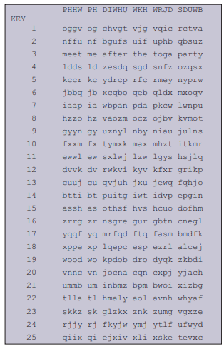
Brute-Force Cryptanalysis of Caesar Cipher

Slide 11
Monoalphabetic Ciphers
A permutation of a finite set of elements S is an ordered sequence of all the elements of S, with each element appearing exactly once.
if S = {a, b, c}, there are six permutations of S:
abc, acb, bac, bca, cab, cba
If, instead, the “cipher” line can be any permutation of the 26 alphabetic characters, then there are 26! or greater than 4 * 10²⁶ possible keys.
This is 10 orders of magnitude greater than the key space for DES and would seem to eliminate brute-force techniques for cryptanalysis

Slide 12
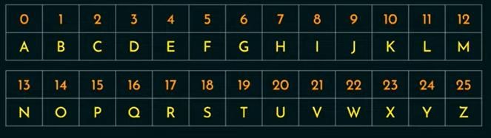
Monoalphabetic …. (cont..)
Plain-text: TRY
Cipher-text: GBW

Slide 13
Cryptanalysis of monoalphabetic
If the cryptanalyst knows the nature of the plaintext (e.g., noncompressed English text), then the analyst can exploit the regularities of the language.
The ciphertext to be solved is
UZQSOVUOHXMOPVGPOZPEVSGZWSZOPFPESXUDBMETSXAIZ VUEPHZHMDZSHZOWSFPAPPDTSVPQUZWYMXUZUHSX EPYEPOPDZSZUFPOMBZWPFUPZHMDJUDTMOHMQ
As a first step, the relative frequency of the letters can be determined and compared to a standard frequency distribution for English.

Slide 14
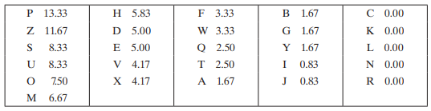
Cryptanalysis…..
Table showing relative frequencies of letters in ciphertext

Slide 15
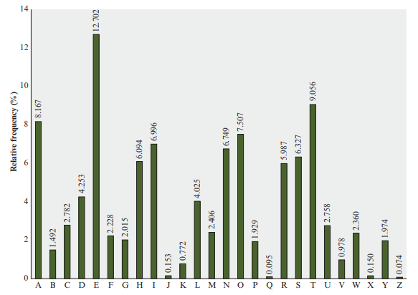
Cryptanalysis….
Relative Frequency of Letters in English Text

Slide 16
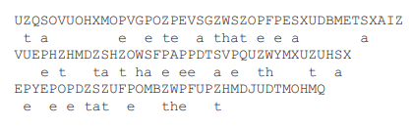
Cryptanalysis….

Slide 17

Cryptanalysis….

Slide 18
Cons & Countermeasure of Monoalphabetic cipher
Monoalphabetic ciphers are easy to break because they reflect the frequency data of the original alphabet.
A countermeasure is to provide multiple substitutes, known as homophones, for a single letter

Slide 19
Polyalphabetic Ciphers
A way to improve monoalphabetic cipher is the use of polyalphabetic cipher.
All these techniques have the following features in common:
A set of related monoalphabetic substitution rules is used.
A key determines which particular rule is chosen for a given transformation.
There are two types of polyalphabetic ciphers
Vigenere Cipher
One-Time pad cipher

Slide 20
Vigenere cipher
In this scheme, the set of related monoalphabetic substitution rules consists of the 26 Caesar ciphers with shifts of 0 through 25.
Each cipher is denoted by a key letter, which is the ciphertext letter that substitutes for the plaintext letter. It is expressed as:
Plaintext letters P = p₀, p₁, p₂, ……… , p_{n-1}
Key K = k₀, k₁, k₂, ……… , k_{m-1}
Cipher letters C =C₀, C₁, C₂, ……… , C_{n-1}

Slide 21

Vigenere cipher
C =C₀, C₁, C₂, ……… , C_{n-1} = E (K,P) = E[(k₀, k₁, k₂, ……… , k_{m-1}), (p₀, p₁, p₂, ……… , p_{n-1})]
= (p₀ + k₀) mod 26, (p₁ + k₁) mod 26, ...,(p_{m-1} + k_{m-1}) mod 26, (p_{m} + k₀) mod 26, (p_{m+1} + k₁) mod 26, c, (p_{2m-1} + k_{m-1}) mod 26,
$C_{i}=\left(p_{i}+k_{i mod m}\right)mod26$, Encrypt equation
$p_{i}=\left(C_{i}−k_{i mod m}\right)mod26,$ Decrypt equation.
To encrypt key must be as long as the message.

Slide 22


Vigenere cipher
if the keyword is deceptive, the message “we are discovered save yourself” is encrypted as:
key: deceptivedeceptivedeceptive
plaintext: wearediscoveredsaveyourself
ciphertext: ZICVTWQNGRZGVTWAVZHCQYGLMGJ

Slide 23
Vigenere cipher - cryptanalysis
Determining the length of the keyword.
Key and the plaintext share the same frequency distribution of letters, a statistical technique can be applied.
Notes:
The strength of this cipher is that there are multiple ciphertext letters for each plaintext letter, one for each unique letter of the keyword.

Slide 24
Vigenere cipher - cryptanalysis
How to determining the length of the keyword?
If two identical sequences of plaintext letters occur at a distance that is an integer multiple of the keyword length, they will generate identical ciphertext sequences.
Notes:
The strength of this cipher is that there are multiple ciphertext letters for each plaintext letter, one for each unique letter of the keyword.

Slide 25
Vigenere cipher - Autokey
The periodic nature of the keyword can be eliminated by using a nonrepeating keyword that is as long as the message itself.
Vigenère proposed what is referred to as an autokey system, in which a keyword is concatenated with the plaintext itself to provide a running key.
key: deceptivewearediscoveredsav
plaintext: wearediscoveredsaveyourself
ciphertext: ZICVTWQNGKZEIIGASXSTSLVVWLA

Slide 26
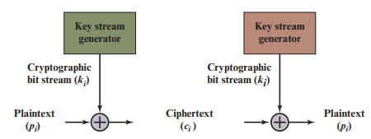

Vernam Cipher
The ultimate defense against such a cryptanalysis is to choose a keyword that is as long as the plaintext and has no statistical relationship to it.
$c_{i}=p_{i}⊕k_{i}$
where $p_{i}=i$ th binary digit of plaintext $k_{i}=i$ th binary digit of key $c_{i}=i$ th binary digit of ciphertext $⊕=$ exclusive-or (XOR) operation
for decryption
$p_{i}=c_{i}⊕k_{i}$
Notes:
. Vernam proposed the use of a running loop of tape that eventually repeated the key, so that in fact the system worked with a very long but repeating keyword. Although such a scheme, with a long key, presents formidable cryptanalytic difficulties, it can be broken with sufficient ciphertext, the use of known or probable plaintext sequences, or both.

